Slide 1

Spot the CATs in our Capability Development Framework:
Empowering and engaging individuals in capability development
Presented by Jess Chalmers and Annissa Villegas

Slide 2

We’re all about Community
Industry
People
http://www.youtube.com/watch?v=FBty1bm-Si4
Notes:
2mins duration

Slide 3
We have a Vision
To inspire regional prosperity and in partnership grown nationally.
We have a Purpose
To build the skills, qualifications and employability of people in regional Australia.

Slide 4


Slide 5
What do we do?
For the past 12 months we have been working on gathering and interpreting data from the JMA Capability Analysis Tools® (CATs) and building a new Capability Development Framework (CDF) . . .
Let’s look at CATs . . .

Slide 6
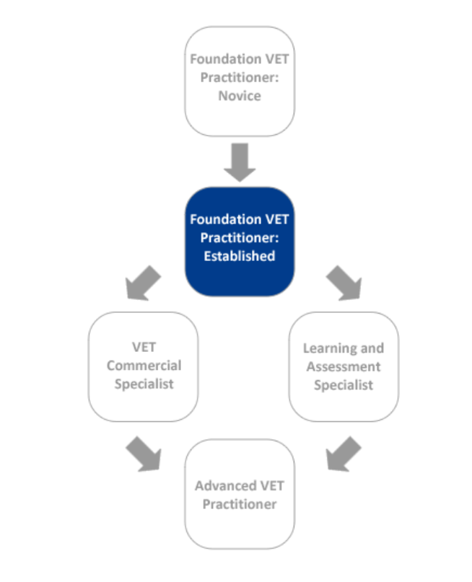
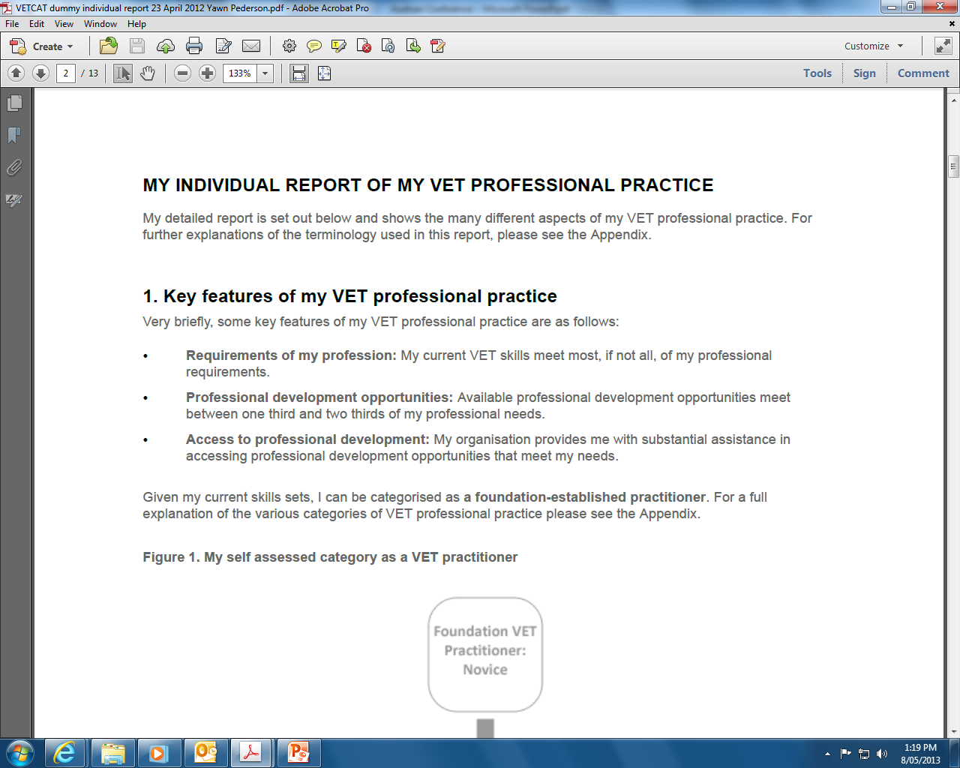
What are the CATs?

Slide 7
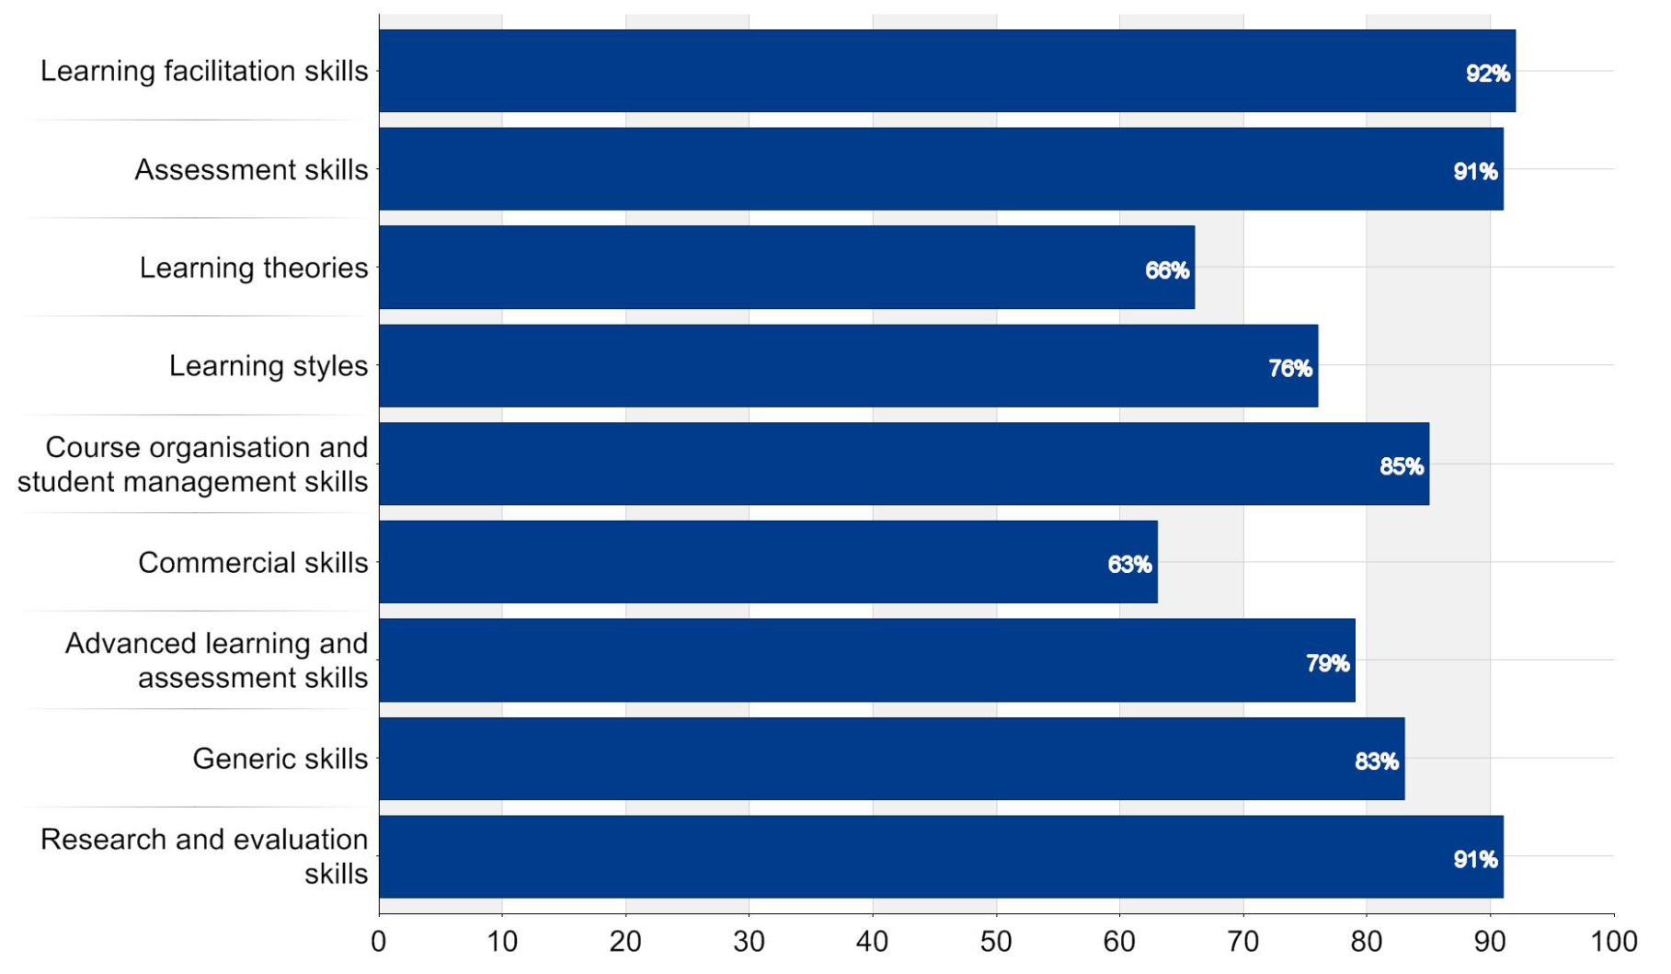
How do CATs empower & engage individuals?

Slide 8
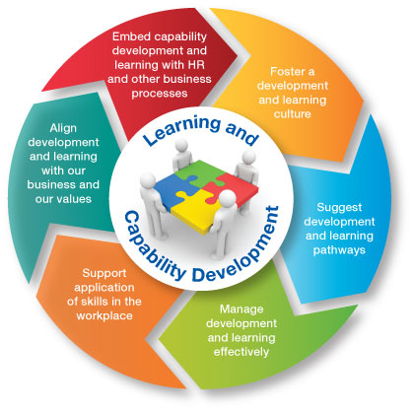
How have the CATs given staff a voice in our new CDF?
Our new CDF embeds a learning and development culture
8

Slide 9
How does the CDF individualise learning?
It encourages ownership and builds connections

Slide 10
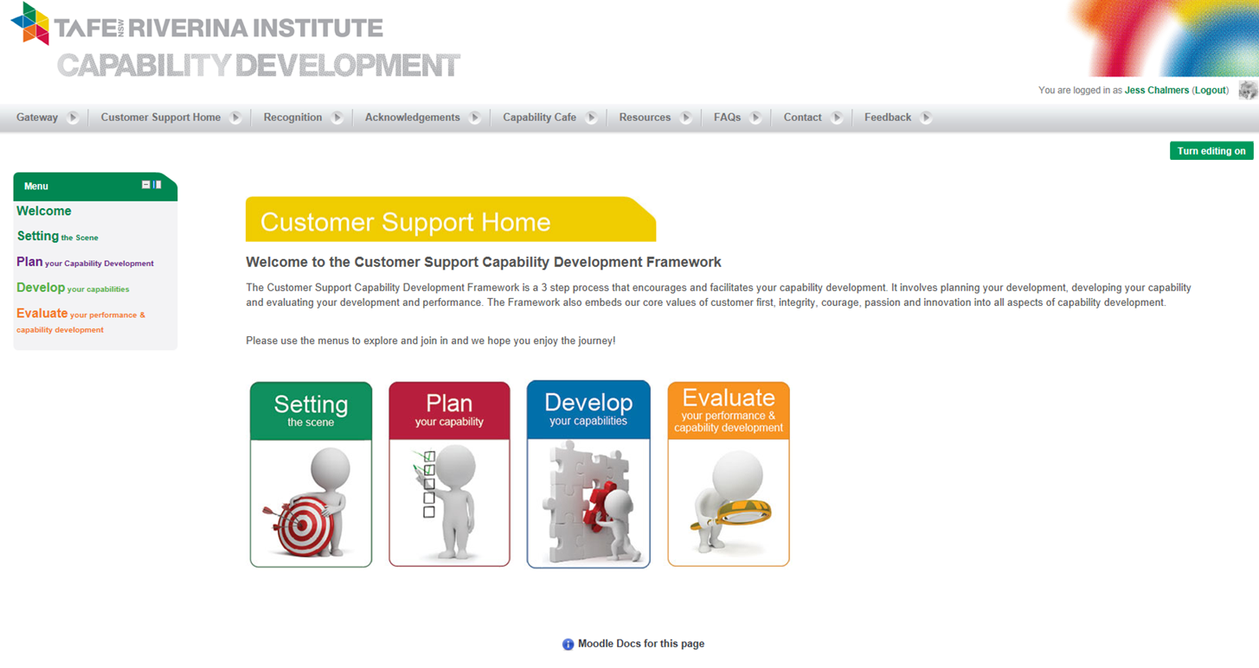
Accessible and sustainable
10

Slide 11
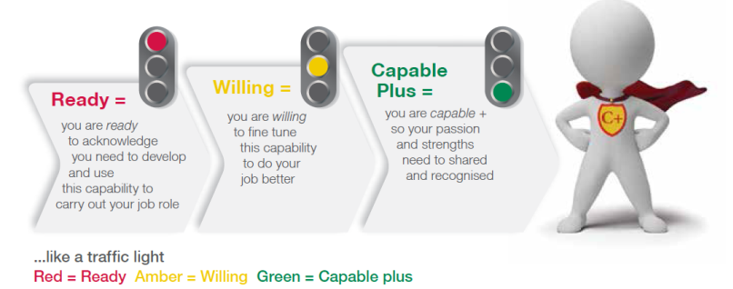
Personalised and engaging
11

Slide 12
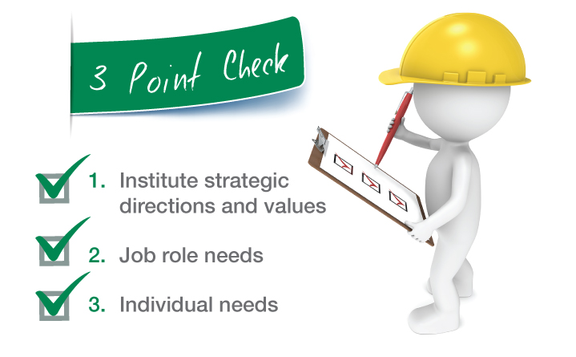
Strategic, benchmarked and aligned
12

Slide 13
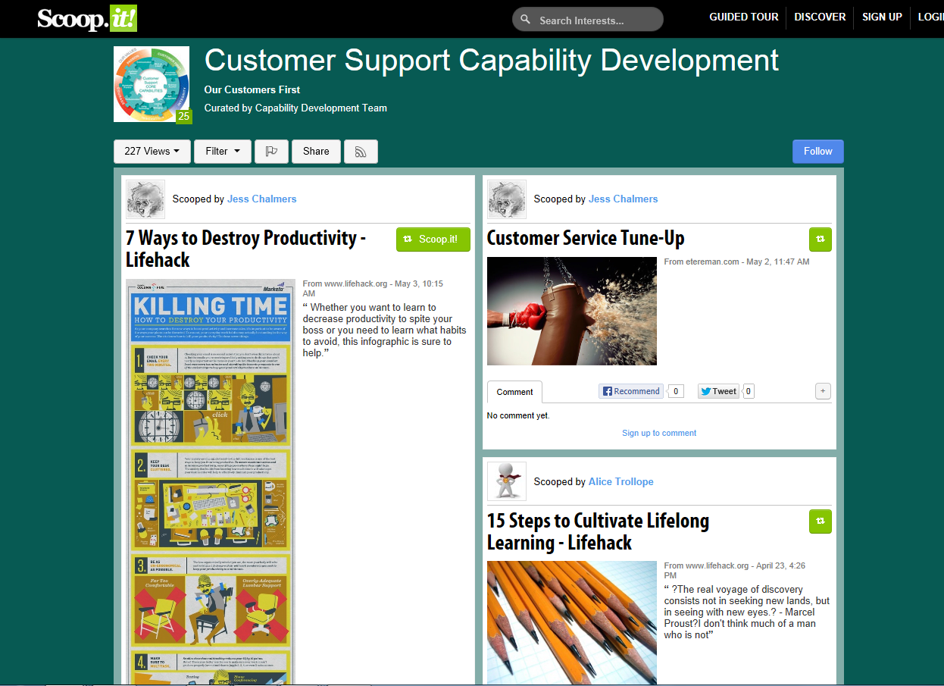
Robust and inclusive
Info sheets
Tips
Videos
Audio
Scoop IT
Collaboration
13

Slide 14
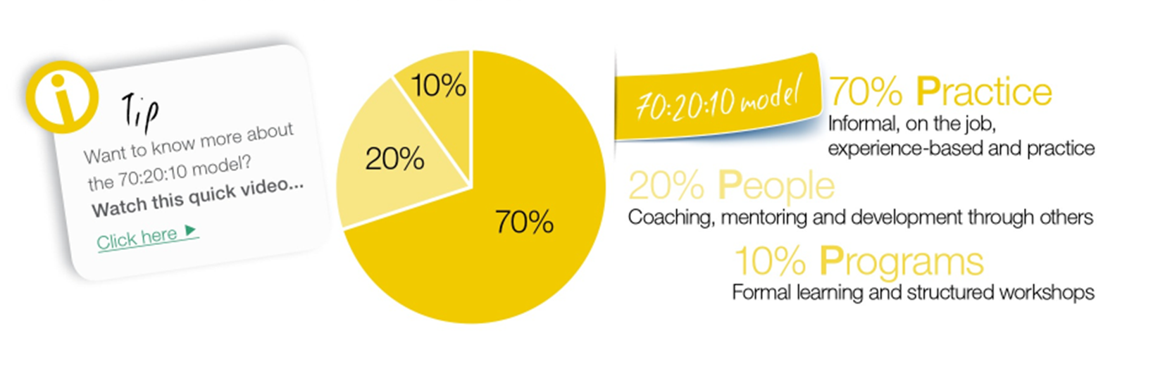
Embeds the 70:20:10 model
http://www.youtube.com/watch?v=t6WX11iqmg0
14
Notes:
4 mins

Slide 15

Collaborative & encourages connections
15

Slide 16

Authentic, targeted and valid
16

Slide 17
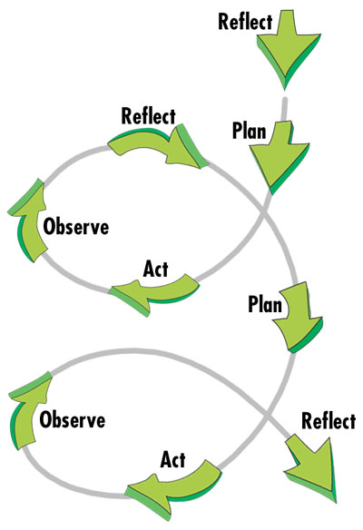

Self reflection and evaluation
Evaluate your performance
Reflect on how you went through the process
Review any learnings

Slide 18

Individualised learning & working in RI is all about . . .
18

Slide 19

So did you spot the CATs in capability development?
C Capability
A Analysis
P Personalised
A Accessible
B Benchmarked
I Inclusive
L Learning culture
I Innovative
T Tools
Y YOU are central to whole process
D Dynamic
E Engaging
V Values driven
E Empowering
L Learner centred
O Opportunities
P Performance Pathways
M Mentors (MEOW)
E Employee driven
N Needs based
T Time framed
19

Slide 20
Paw prints forward
Where to from here??
Riverina Institute
John Mitchell and Associates
Get the Scoop on Training and Assessment
Get the Scoop on Literacy and Numeracy
Get the Scoop on Leadership
TAFE NSW
And now the CATs quiz to see if you were paying attention!!
What is the title of this song and who sings it?

