Slide 1
Conference of the German Speaking Countries
Individualised Learning and Working
9th – 11th of May 2013 Graz, Austria
Notes:
Check equipment
Check notes copied
Check music etc

Slide 2

Spot the CATs in our Capability Development Framework:
Empowering and engaging individuals in capability development
Presented by Jess Chalmers and Annissa Villegas

Slide 3


Would you like to meet us?

Slide 4


Jess Chalmers
Project Officer, Capability Development
(and CAT woman extraordinaire!)
Activities:
Research and development Capability
Development Framework (CDF)
Liaison and management of stakeholders
Implement CATs findings into CDF
Development of all learning objects
Engage, enliven and excite Capability development
Notes:
Jess Chalmers
Title: Project Officer, Capability Development (and CAT woman extraordinaire!)
Activities:
Research and development of new Institute Capability Development Framework (instructional design and development of inclusive content for framework situated in a Moodle site)
Liaising with and management of project stakeholders
Implementing CAT findings into CDF
Development of eforms and resources to support Framework (to gather analytics)
Development of learning objects

Slide 5
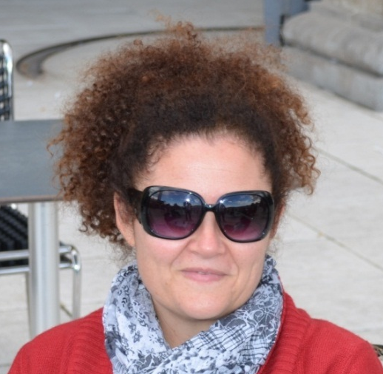
Nissa Villegas
Workforce Development Officer,
Capability Development (and crazy CAT woman)
Activities:
Project Officer for rollout of JMA Capability Analysis Tools® (CATs) (2012)
Analyse and interpret JMA Institute
Summary Reports (CAT data)
Disseminate information to key stakeholders
Suggest Institute wide CD programs to develop capability and feed into CD Framework
5

Slide 6
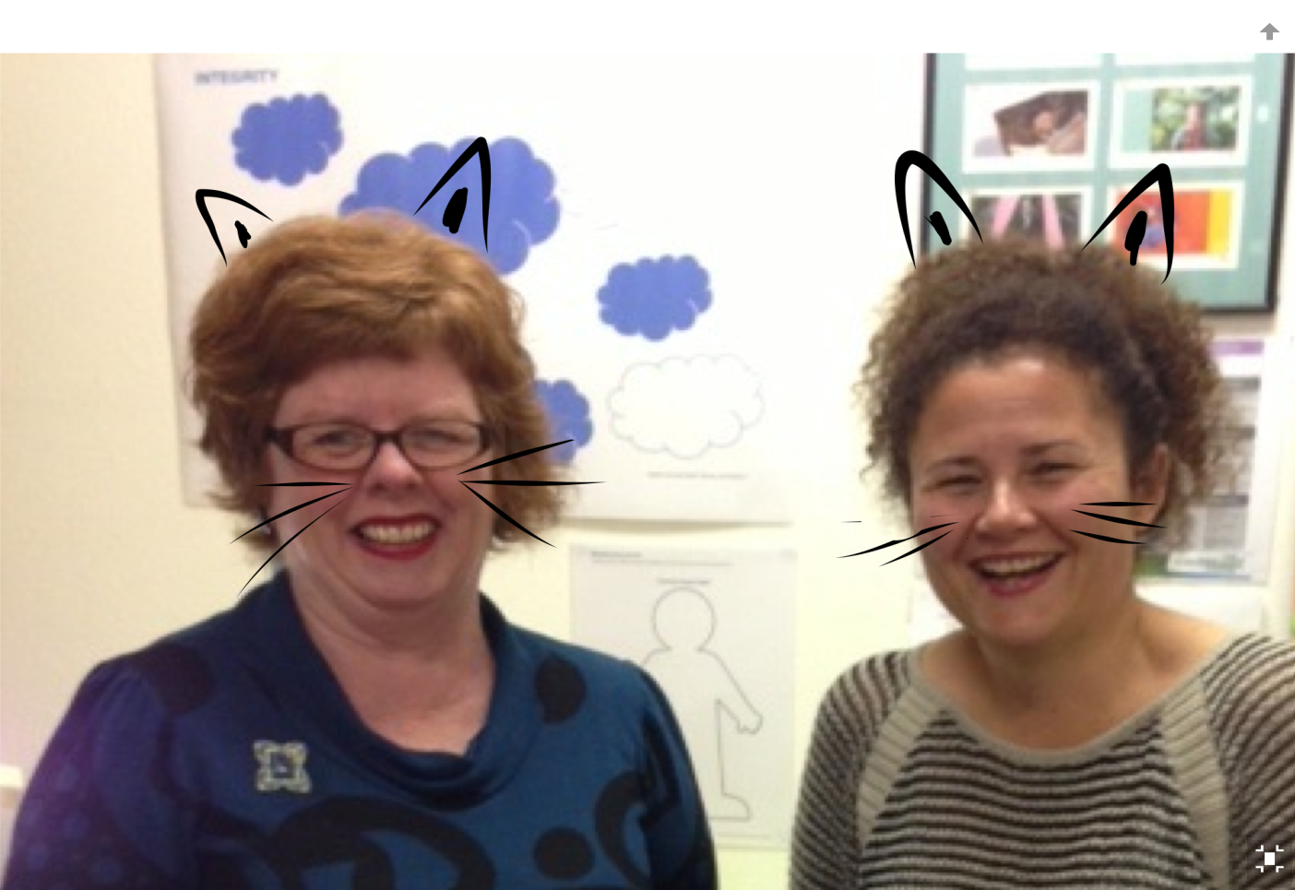
This is where we work . . . the Capability Cave!

Slide 7
Please allow us to introduce our Institute

Slide 8
TAFE NSW is the largest provider of public vocational education and training (VET) in Australia and the southern hemisphere
Riverina Institute is one of the ten Institutes that makes up TAFE NSW

Slide 9
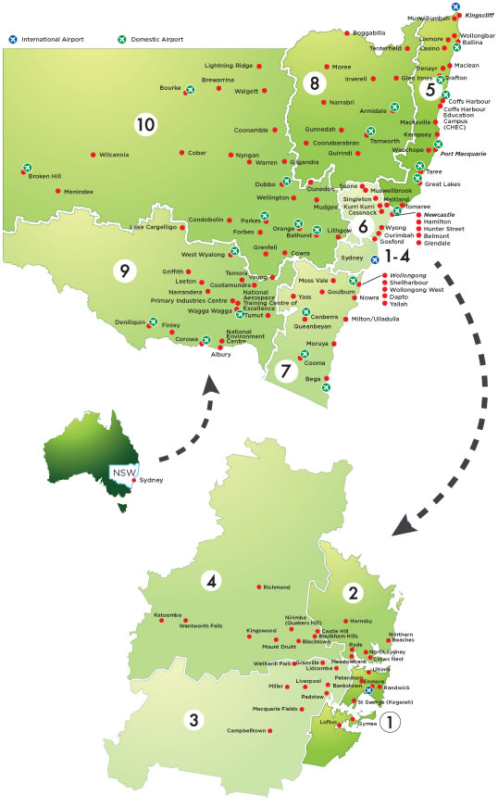
Our Institute

Slide 10

RI facts at a glance
19 campuses across 154,500 square km of southern New South Wales - a geographic footprint almost 2 times the size of Austria!
1,465 staff (901 teachers)
32,557 students enrolled in over 559 courses in 2011
1 in 5 students studying flexibly and 1 in 5 students gaining their qualification in the workplace

Slide 11
