Slide 1
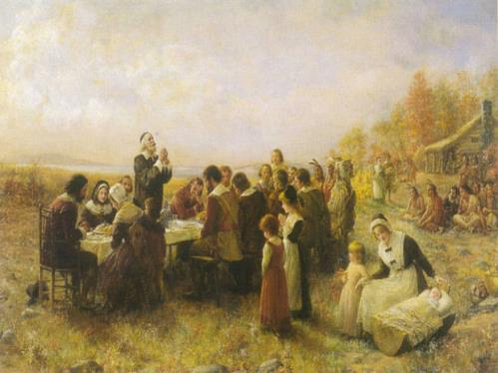
The Puritan Mind
in Early American Culture
Stefan Brandt – stefan.brandt@uni-graz.at
Karl-Franzens-Universität Graz
Guest Professor
Università Ca‘ Foscari, Venice

Slide 2
Time Travel

Slide 3
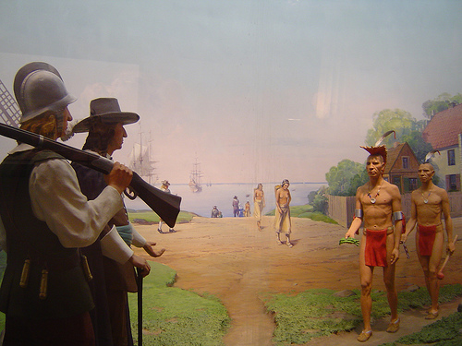
First encounters between European settlers and Native Americans

Slide 4
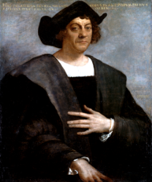
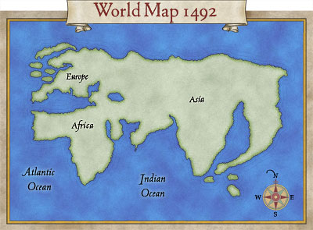
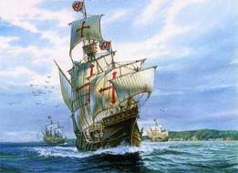
Christopher Columbus (1451-1506)
Italian navigator and explorer
Santa Maria
(Columbus‘s ship)
Obsessed with finding India in the West

Slide 5
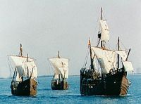
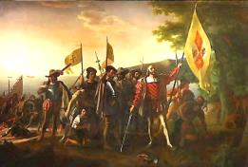
Christopher Columbus (1451-1506)
Sets out for an expedition into the “New World” in 1492, financed by Queen Isabella of Spain (Queen of Castile and León) and her husband, Ferdinand II (King of Aragon), determined to find a new route to India.
Starts his first journey from Spain on Aug. 3, 1492 with three ships (Niña, Pinta, and Santa Maria)
Lands at the Bahamas in the Caribbean on Oct. 12, 1492
Calls the region the “Indies” and the island “San Salvador”

Slide 6
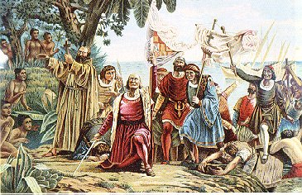
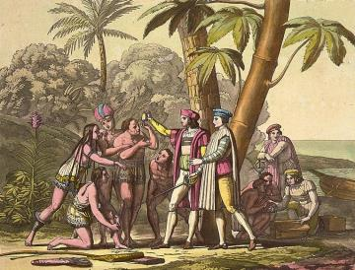
Terrestrial Paradise
“I believe that the earthly Paradise lies here, which no one can enter except by God’s leave.” Christopher Columbus, “Third Voyage” (1498-1500)

Slide 7
The Americas in the 16th and 17th Centuries

Slide 8
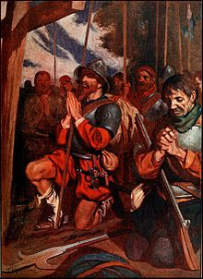
The Conquistadores in South America
(Soldiers, explorers, adventurers at the service of the Spanish and Portuguese empire, 16th century)

Slide 9
New England: A New Era Begins
(17th century)

Slide 10
Pop Quiz
“The Puritan Mind in Early American Culture”
Choose the correct letter
(A, B, C, or D)

Slide 11
$ 100
Which village was the first permanent English settlement on North American soil?
A: Jamestown
B: Point Arrowhead
C: Kennebunkport
D: Fort Duckburg

Slide 12
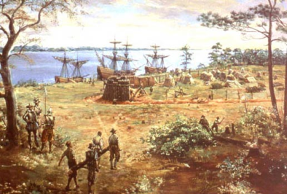
Jamestown
Founded as a fortress by English settlers in the still young Virginia Colony on May 14, 1607
How many women were among the first settlers in Jamestown?
None – The first women arrived in 1609.
Was life in Jamestown easy?
Early Troubles:
- Lawlessness
- Sickness
- Food shortages
- Battles with natives

Slide 13
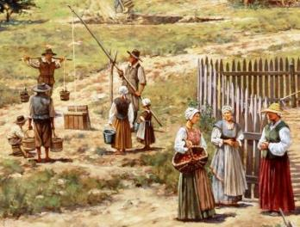
Jamestown
A year after its foundation, in 1608, 200 new settlers arrived.
How many of them were still alive by the end of the year?
53

Slide 14
$ 200
How many Native Americans lived near Chesapeake Bay around Jamestown?
A: Ca. 140
B: Ca. 1,400
C: 14,000
D: Ca. 140,000

Slide 15
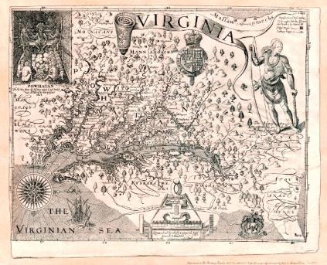
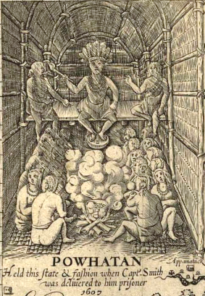
The area near the Jamestown settlement (Chesapeake Bay) was inhabited by ca. 14,000 natives.
This group of natives was known as the “Powhatan Confederacy” named after their powerful chief.

Slide 16
$ 300
Powhatan‘s daughter, whose tribal name was Matoaka, became famous as …
A: Apanatschi
B: Pocahontas
C: Nscho-tschi
D: Klekih-Petra

Slide 17
‘Pocahontas’ (c. 1595-1617)
Pocahontas was Powhatan‘s daughter. She assisted the colonists in Jamestown, Virginia, and allegedly saved Captain John Smith‘s life (ca. 1607/08).

Slide 18
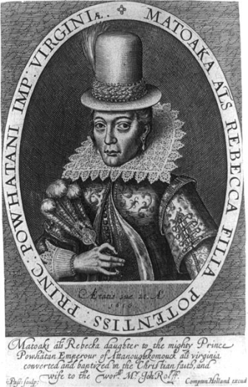
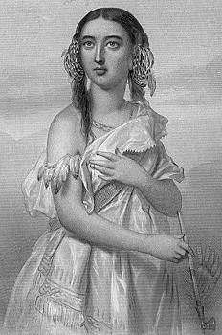
Pocahontas converted to Christianity in 1614, assuming the name Rebecca.

Slide 19
$ 500
Which town was the site of the first colony founded by the Pilgrims in 1620?
A: Buick
B: Dodge
C: Lincoln
D: Plymouth

Slide 20
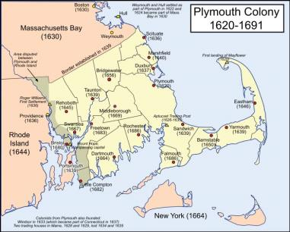
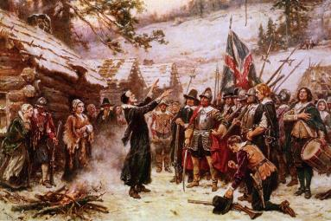
The Pilgrims landing on Plymouth Rock
“Plymouth Colony” (1638)
by Dutch artist Adam Willaerts
Plymouth = “America’s Hometown”
Oldest Municipality in New England

Slide 21
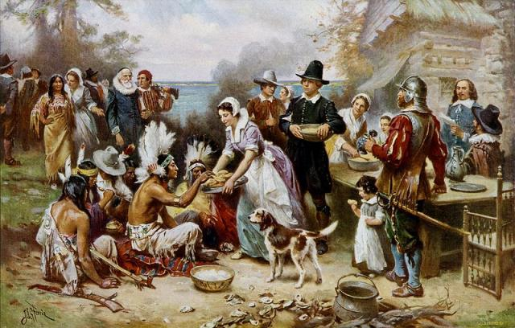
Thanksgiving
First celebrated in Plymouth in 1621 to thank God for a good harvest
(in union with Native Americans)

Slide 22
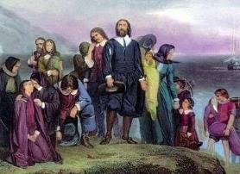
Religion
HS Brandt 32 111 Puritan America? Religious Fundamentalism, Bible Politics, and the Rhetoric of Redemption — 17th Century to Present
“Men are saved by their faith, not by their deeds.” (Miller & Johnson, The Puritans, p. 10)
Colonists were required by law to attend two divine services every Sunday.
Asceticism (Faith was held above all other things, worldly pleasures were condemned.)

Slide 23
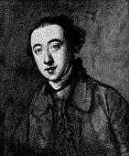
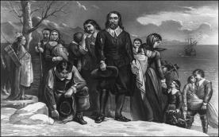
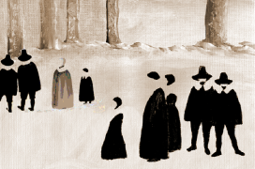
Three important religious groups in New England
Pilgrims
Founded the Plymouth colony in 1620 (Massachusetts)
- Saw the Church of England as impure
- Strongly separatist
- Independence of local churches
Presbyterians
- Origins in Scotland
- Government of ‘Elders’
- Calvinist theology
- Emphasis on education and life-long learning
- Authority of the Scripture
Puritans
- Settled in Virginia and Massachusetts Bay, predominant group
- Developed a “church-centered” society in the New England colonies
- “Only the ‘truly elect’ should be admitted to church membership.” (“Grace of God”)

Slide 24
Puritanism
- Religious reform movement within the Church of England in the 1560s
- Term of contempt assigned to the movement by its enemies

Slide 25
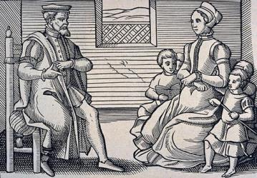
“We call you Puritans not because you are purer than other men but because you think yourselves to be purer.” (Oliver Ormerod, English clergyman, 1603)
Puritan family around 1563

Slide 26
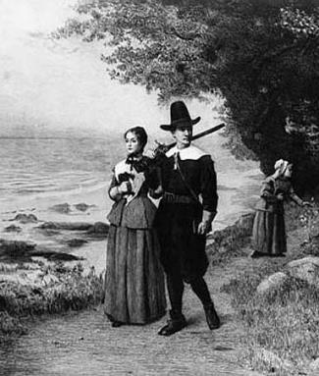
The Puritans
Terminology
Goal of Puritanism: ‘Purification’ of the Church of England of its Catholic aspects
Calvinism –
Reformed theology similar to Protestantism (Belief in the absolute sovereignty of God)
Doctrines of ‘Predestination’ and ‘Original Sin’ (‘Total Depravity’)

Slide 27
$ 1,000
The 102 Pilgrims who landed at Cape Cod on November 21, 1620, were sailing on a ship called …
A: Marchhare
B: April‘s Fool
C: Mayflower
D: 4th of July

Slide 28
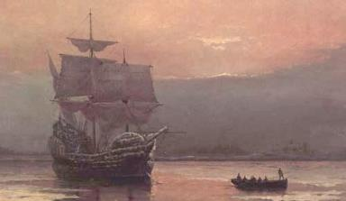
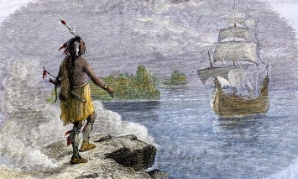
Arrival of the Mayflower at Cape Cod (Massachusetts Coast) on Nov. 21, 1620
The Indian who contacted the Pilgrims shortly after their arrival already spoke English.
He had learned it from Squanto, a Patuxet Indian who had been enslaved by the English explorers in Maine in 1605 and had returned to his homeland in 1619. (Squanto also showed the settlers how to grow crops.)

Slide 29
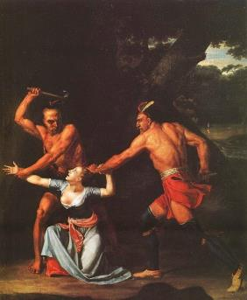
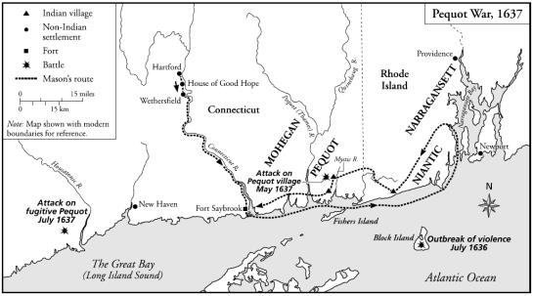
Indian Wars
Pequot War of 1637/38

Slide 30
Famous account of the Pequot War?

Slide 31
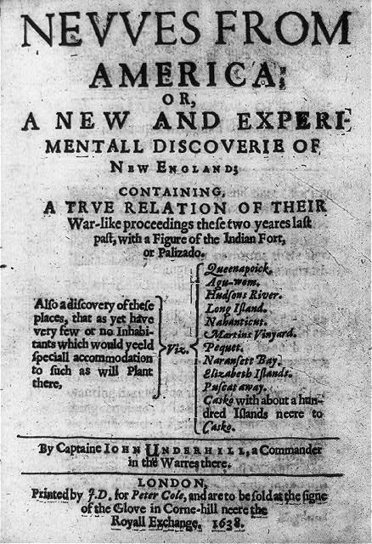
John Underhill,
“Newes from America” (1638)

Slide 32
John Underhill, “Newes from America“ (1638)
“...that insolent and barbarous nation called the Pequeats [sic!]“ (p. 49)
“So insolent were these little imps grown, that like the devil [...], they run up and down as roaring lions, compassing all corners of the country for a prey, seeking whom they might devour“ (p. 66)

Slide 33
‘Sinners against God’
“Should not Christians have more mercy and compassion? But I would refer you to David’s war. When a people is grown to such a height of blood, and sin against God and man […], there he hath no respect to persons, but […] puts them to the sword, and the most terriblest death that may be. […] We had sufficient light from the word of God for our proceedings” John Underhill, “Newes form America” (1637, 81)

Slide 34
Converting the ‘Heathens’

Slide 35
$ 2,000
Between 1646 and 1675, the Puritans tried to convert Indians to Christians in so-called …
A: “Confirmation Courses”“
B: “Dianetic Workshops”
C: “Evangelical Circles”
D: “Praying Towns”

Slide 36
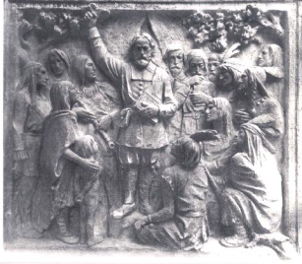
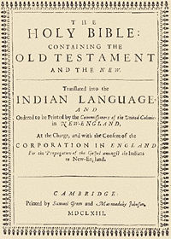
PRAYING TOWNS
The so-called “praying towns” (1646-1674) were little villages with church service. They were built by the Puritans to convert local native tribes to Christianity
Many Puritans thought that the Indians represented the “Lost Tribes of Israel.”

Slide 37
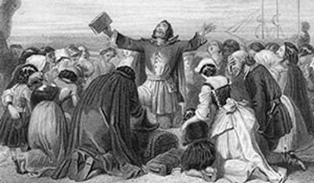
The Puritan Mind
Strong Mission
“Puritans had a particularly clear, an almost abnormally intense vision of man hemmed in between God and nature, at the mercy of malevolent forces and crushing objects.” Perry Miller, The New England Mind (1939)

Slide 38
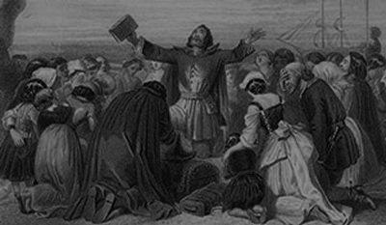
Sermons

Slide 39
One of the first influential sermons of the Puritan era
was held by…

Slide 40
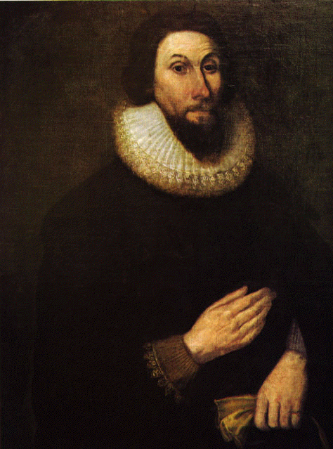
John Winthrop (1588-1649)
“We shall be as a city upon a hill. The eyes of all people are upon us.”
(John Winthrop, “A Model of Christian Charity”, 1630)
The sermon was held in 1630 aboard the ship Arbella on its way to the New World.
But it was NOT printed until the 1830s!

Slide 41
John Winthrop (1588-1649)
Governor of the Massachusetts Bay Company (1629)
Winthrop symbolizes the Christian mission (evangelization of the heathens)

Slide 42
COVENANT WITH GOD
God has entered into a ‘contract’ not only with individuals, but with a people.

Slide 43
$ 4,000
Which religious book from 1662 is usually considered the first American bestseller?
A: The Day After Tomorrow
B: The Day of Doom
C: The Day of the Locust
D: The Day the Earth Stood Still

Slide 44
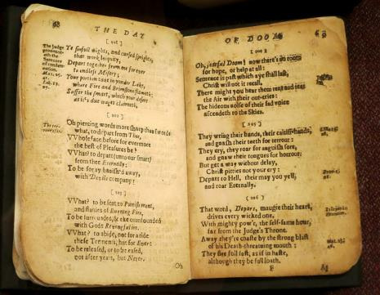
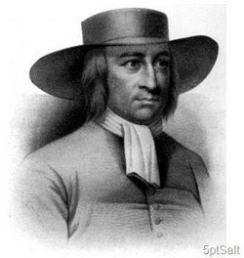
The First American Bestseller
Michael Wigglesworth
1631-1705
Theologian, preacher, poet
The Day of Doom (1662)

Slide 45
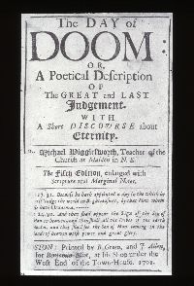
“God’s Controversy with New England”
(Opening poem of The Day of Doom, 1662)
“Beyond the great Atlantick flood
There is a region vast,
A country where no English foot
In former ages past:
A waste and howling wilderness,
Where none inhabited
But hellish fiends, and brutish men
That Devils worshiped.
This region was in darkness plac’t
Far off from heavens light,
Amidst the shaddows of grim death
And of eternal night.”
(Lines 21-32)

Slide 46
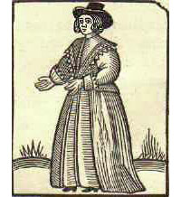
Wigglesworth book belongs to the Genre of…
The Jeremiad

Slide 47
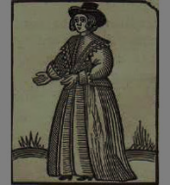
What is a Jeremiad?
A longer epic of lamentation, written in prose or verse.
The term ‘Jeremiad’ comes from the Biblical prophet Jeremiah.
Next to the sermon, the Jeremiad is the second most important type of Colonial Literature

Slide 48
$ 8,000
The third important literary genre
in colonial America was the …
A: Pirate Tale
B: Captivity Narrative
C: Sentimental Novel
D: Bildungsroman

Slide 49
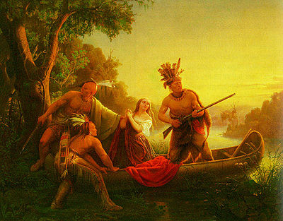
What is a Captivity Narrative?
A presumably truthful account of a white settler taken captive by ‘uncivilized’ natives.

Slide 50
Which is the best-known captivity narrative of the 17th century?

Slide 51
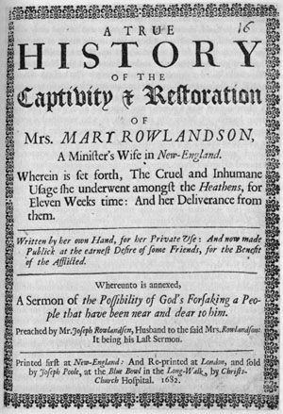
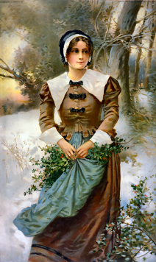
Mary Rowlandson
(1637-1711)
Author of the most influential captivity narrative

Slide 52
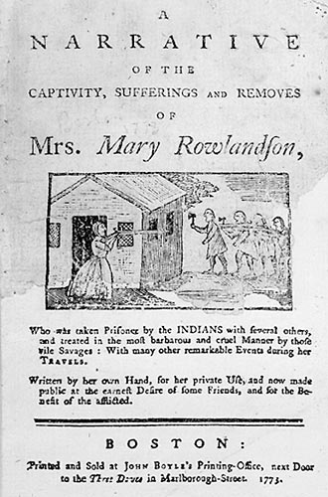
“Yet the Lord still showed mercy to me, and upheld me; and as soon as he wounded me with one hand, so he healed me with the other.” Mary Rowlandson (1682)

Slide 53
Themes and Characteristics
of the
Captivity Narrative

Slide 54
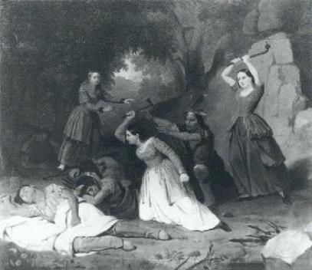
The Captivity Narrative
The captivity is seen as God’s test for the believers (and, simultaneously, as a punishment for potential wrongdoing).
Typically, these narratives end with a notion of redemption.
The protagonist is saved from evil
and delivered from sin.

Slide 55
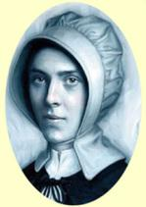
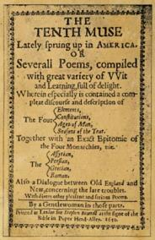
Anne Bradstreet
(1612-1672)
Puritan Poetry
First poet and first female writer in the British colonies to be published.
The Tenth Muse Lately Sprung Up in America (1850)
Collection of poems, mostly dealing with Puritan family life.

Slide 56
$ 16,000
Which community was founded by the English cleric Roger Williams in 1636?
A: Fate
B: Destiny
C: Providence
D: God‘s Will

Slide 57
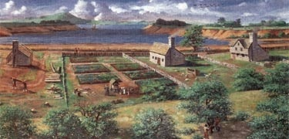
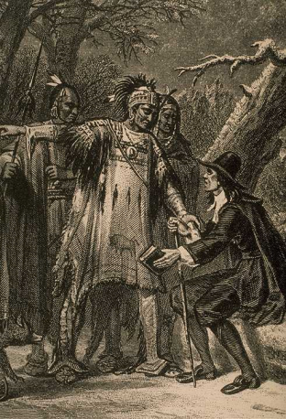
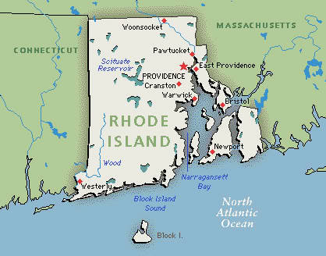
Providence, Rhode Island (1636)

Slide 58
Roger Williams (1603-1683)
Father of American Baptism
Fighter for religious freedom
(separation of State and Church)
Banned from Massachusetts, then fled to Rhode Island

Slide 59
$ 32,000
Which Puritan minister first used the image of the colonies as “God‘s plantation”?
A: Jack Wool
B: John Cotton
C: Jerome Fur
D: Jerry Yarn

Slide 60
John Cotton (1595-1652)
Puritan minister and one of the most influential representatives of the Massachusetts Bay Colony

Slide 61
He also wrote first sermon that came into print…

Slide 62
God’s Promise to His Plantation (1630)
by John Cotton
John Cotton preached to the English colonists in Plymouth, England, who were about to set sail to New England with John Winthrop’s fleet.
God‘s Chosen People
References to the Bible:
“[God:] I will appoint a place for my people Israel, and I will plant them, that they may dwell in a place of their own, and move no more” Samuel 7:10

Slide 63
God’s Promise to His Plantation (1630)
by John Cotton
“God makes room for a people in three ways:
First, when He casts out the enemies of a people before them by lawful war with inhabitants.
Second, when He gives a foreign people favor in the eyes of any native people to come to sit down with them either by way of purchase […] or else when they give it in courtesy.
Thirdly, when He makes a country […] void in the place where [the settlers] reside.”

Slide 64
What happened to people who dissented from the official creed?

Slide 65
Anne Hutchinson (1591-1643)
Hutchinson, a theologian and author, was persecuted for antinomianism.
Antinomianism
The belief that churches and the clergy were basically superfluous (and that the study of the scriptures was sufficient for salvation).
Hutchinson had “infected” other members of her family with her beliefs (according to John Winthrop who led the trial)
She was banned from Massachusetts and fled to Rhode Island where she joined Roger Williams.
After the Hutchinson Trial, women were forbidden by law to speak in churches.

Slide 66
$ 64,000
Which activity became prohibited by law in New Amsterdam during the time of church services in 1658?
A: Cursing
B: Having lunch
C: Playing Tennis
D: Shooting

Slide 67
In 1658, it became a law in New Amsterdam that tennis was not allowed during church service. The law was enacted by Governor Peter Stuyvesant (1612-1672).

Slide 68
$ 125,000
Which utensil was introduced to America by John Winthrop in 1630?
A: Binoculars
B: Fork
C: Hammer
D: Rope

Slide 69
John Winthrop brought the fork to America in 1630 in a leather case together with a dagger and a knife.
The utensil had been popularized in England by Queen Elizabeth despite the condemnation of the practice by the clergy.

Slide 70
$ 250,000
In 1692, the infamous “Witch Trials“ took place at …
A: Salinas
B: Salieri
C: Salem
D: Salome

Slide 71
Witch Trials in New England (1620-1725)
Some 334 people were accused of witchcraft in New England between 1620 and 1725.
35 of them were executed.
Almost 80 % of the accused were women.
The Salem Witch Trials (1692)
FEAR of “a more gross diabolism than ever the world saw before.” (Cotton Mather, Wonders of the Invisible World, 1693, p. 227)

Slide 72
Cotton Mather (1663-1728)
Prominent Puritan minister, author, and pamphleteer
Chief representative of the witch-hunt

Slide 73
$ 500,000
Which is the ‘scarlet letter’ in Hawthorne’s eponymous novel about Puritanism?
A: A
B: B
C: C
D: D

Slide 74
The Scarlet Letter (1850)
by Nathaniel Hawthorne
Plot in a nutshell
Set in the Puritan city of Boston in the 1640s, the novel relates the story of Hester Prynne who, believing her husband is dead, engages in an adulterous affair with a reverend, conceives an illegitimate child, and is ostracized by the community which forces her to wear the red letter ‘A’ on her clothes (‘A’ for ‘adultery’).
Main themes?
The Religious Concepts of Sin and Repentance
America’s Puritan Past
History of witch-hunting in 17th century

Slide 75
Key symbol
“It was the capital letter A. […]. It had been intended […] as an ornamental article of dress; but how it was to be worn […] was a riddle which […] I saw little hope of solving. […]
I happened to place it on my breast. It seemed to me […] that I experienced a sensation not altogether physical, yet almost so, as of burning heat, and as if the letter were not of red cloth, but red-hot iron. I shuddered, and involuntarily let it fall upon the floor.”
Nathaniel Hawthorne, The Scarlet Letter (1850)

Slide 76
$ 1,000,000
Jonathan Edwards, mastermind of the ‘Great Awakening’ of the 1740s, entered Yale College at the age of…
A: 13
B: 17
C: 28
D: 55

Slide 77
Jonathan Edwards (1703-1758)
Important and American philosopher and theologian (“the most important one”)
Entered Yale College (later: Yale University) at the age of 13.
Studied Philosophy and Natural Science (J. Locke, I. Newton) →nature is proof of God’s masterful plan.
Published numerous sermons and philosophical treatises, based in Calvinist and Puritan thinking → his works comprise 26 volumes
Became President of College of New Jersey (later: Princeton).
Died of unsuccessful smallpox inoculation (early vaccination method) →He wanted to encourage others to do the same and become immune.

Slide 78
Edwards was
the mastermind of the …

Slide 79
The Great Awakening
Period of renewed interest in religion (1720s-1750s)

Slide 80
His most important work was …
Sinners in the Hands of …
an Angry God (1741)
Portrayed a punishing God dissatisfied with the wrongdoing of his ‘children.’

Slide 81
“God is a great deal more angry with great numbers that are now on earth [...]. The wrath of God burns against them, their damnation does not slumber; the pit is prepared, fire is made ready, the furnace is now hot, ready to receive them; the flames do now rage and glow.” (Jonathan Edwards, Sinners in the Hands of an Angry God, 342)

Slide 82
Fire and Brimstone

