Slide 1
Utility Maximization
and Choice

Slide 2
The Plan
Utility maximization (☞ Marshallian demand)
Two-good case
N-good case
Indirect utility function
Expenditure minimization (☞ Hicksian demand)
Expenditure function

Slide 3
Utility Maximization (principle)
Optimization principle, Utility maximization
Main behavioral model
People act so as to maximize utility, constraint: fixed amount of income to spend
An individual will buy those quantities of goods
that exhaust his or her total income (monotonicity!)
for which the MRS is equal to the rate at which the goods can be traded one for the other in the marketplace (maximization!)
MRS (of x for y) = (p_{x}/p_{y})

Slide 4
The Two-Good Case
Individual chooses among 2 goods
Budget: I dollars to allocate between good x and good y
p_{x} - price of good x
p_{y} - price of good y
Budget constraint: p_{x}x + p_{y}y ≤ I
Slope = -p_{x}/p_{y}
If all of I is spent on good x, buy I/p_{x} units of good x
Query: How many units if all I is spent on good y? What are the exogenous/endogenous vars?

Slide 5
4.1
The Individual’s Budget Constraint for Two Goods
Quantity of y
I=p_{x}x+p_{y}y
Quantity of x
Those combinations of x and y that the individual can afford are shown in the shaded triangle. The slope of this straight-line boundary is given by –p_{x}/p_{y}.
Query. Properties of budget set

Slide 6
The Two-Good Case
First-order conditions for a maximum
Point of tangency between the budget constraint and the indifference curve:

Slide 7
4.2
A Graphical Demonstration of Utility Maximization
Quantity of y
B
D
C
I=p_{x}x+p_{y}y
y*
U₃
A
U₂
U₁
Quantity of x
x*
Point C represents the highest utility level that can be reached by the individual, given the budget constraint. Therefore, the combination x*,y* is the rational way for the individual to allocate purchasing power. Only for this combination of goods will two conditions hold: All available funds will be spent, and the individual’s psychic rate of trade-off (MRS) will be equal to the rate at which the goods can be traded in the market ( p_{x}/p_{y}).

Slide 8
The Two-Good Case
The tangency rule
Is not sufficient
If MRS is not diminishing, we must check second-order conditions to ensure that we are at a maximum
What about points A and D in the previous figure?
Query. Is tangency rule necessary?
Notes:
ONLY for interior solutions, not for boundary solutions

Slide 9
4.3
Example of an Indifference Curve Map for Which the Tangency Condition Does Not Ensure a Maximum
Quantity of y
A
C
U₃
U₂
U₁
B
Quantity of x
Query. What about perfect substitutes? Give a graphical illustration.

Slide 10
The Two-Good Case
Corner (boundary) solutions
Individuals may maximize utility by choosing to consume only one of the goods
Query. At the optimal point, is the budget constraint flatter/steeper than the indifference curve?
Think about (x,0) respectively (0,y) being the optimal consumption bundles.
Query. Possible that Individuals may maximize utility by choosing none of the goods?
Notes:
Monotonicity!

Slide 11
4.4
Corner (Boundary) Solution for Utility Maximization
Quantity of y
U₁
U₂
U₃
Quantity of x
x*
With the preferences represented by this set of indifference curves, utility maximization occurs at E, where 0 amounts of good y are consumed. The first-order conditions for a maximum must be modified somewhat to accommodate this possibility.
Query. What happens when the indifference curves are everywhere flatter than px/py?

Slide 12
The n-Good Case (Lagrange method)
The individual’s objective is to maximize
utility = U(x₁,x₂,…,x_{n})
subject to the budget constraint
I = p₁x₁ + p₂x₂ +…+ p_{n}x_{n}
Set up the Lagrangian:
ℒ = U(x₁,x₂,…,x_{n}) + λ(I - p₁x₁ - p₂x₂ -…- p_{n}x_{n})
Query. Interpret the Lagrange multiplier

Slide 13
The n-Good Case
(n+1) first-order conditions for an interior maximum
∂ℒ/∂x₁ = ∂U/∂x₁ - λp₁ = 0
∂ℒ /∂x₂ = ∂U/∂x₂ - λp₂ = 0
…
∂ℒ /∂x_{n} = ∂U/∂x_{n} - λp_{n} = 0
∂ℒ /∂λ= I - p₁x₁ - p₂x₂ - … - p_{n}x_{n} = 0

Slide 14
The n-Good Case
Implications of first-order conditions
For any two goods, x_{i} and x_{j}:

Slide 15
The n-Good Case
Interpreting the Lagrange multiplier
λ is the marginal utility of an extra dollar of consumption expenditure (of income)

Slide 16
The n-Good Case
Notes:
Lambda converts marginal utility to monetary (income) units

Slide 17
The n-Good Case
Corner solutions (Kuhn-Tucker conditions)
Means that the first-order conditions must be modified:
∂ℒ/∂x_{i} = ∂U/∂x_{i} - λp_{i} ≤ 0 (i = 1,…,n)
If ∂ℒ/∂x_{i} = ∂U/∂x_{i} - λp_{i} < 0, then x_{i} = 0
This means that
any good whose price exceeds its marginal value to the consumer will not be purchased

Slide 18
4.1 Cobb–Douglas Demand Functions
Cobb-Douglas utility function:
U(x,y) = x^{α}y^{β}
Setting up the Lagrangian:
ℒ = x^{α}y^{β}+ λ(I - p_{x}x - p_{y}y)
First-order conditions:
∂ℒ/∂x = αx^{α-1}y^{β}- λp_{x} = 0
∂ℒ/∂y = βx^{α}y^{β-1} - λp_{y} = 0
∂ℒ/∂λ= I - p_{x}x - p_{y}y = 0

Slide 19
4.1 Cobb–Douglas Demand Functions
First-order conditions imply: αy/βx = p_{x}/p_{y}
If α+ β= 1: p_{y}y = (β/α)p_{x}x = [(1- α)/α]p_{x}x
Substituting into the budget constraint:
I = p_{x}x + [(1- α)/α]p_{x}x = (1/α)p_{x}x
Solving: x*=αI/p_{x} and y*=βI/p_{y}
The individual will allocate α percent of his income to good x and β percent of his income to good y
Notes:
Notice: x = alpha/(alpha+beta) I/px; y = beta/(alpha+beta) I/py; in general

Slide 20
4.1 Cobb–Douglas Demand Functions
Cobb-Douglas utility function
Is limited in its ability to explain actual consumption behavior
The share of income devoted to a good often changes in response to changing economic conditions
A more general functional form might be more useful

Slide 21
4.2 CES Demand
Assume that δ= 0.5
U(x,y) = x^{0.5} + y^{0.5}
Setting up the Lagrangian:
ℒ = x^{0.5} + y^{0.5} + λ(I - p_{x}x - p_{y}y)
First-order conditions for a maximum:
∂ℒ/∂x = 0.5x ^{-0.5} - λp_{x} = 0
∂ℒ/∂y = 0.5y ^{-0.5} - λp_{y} = 0
∂ℒ/∂λ= I - p_{x}x - p_{y}y = 0

Slide 22
4.2 CES Demand
This means that: (y/x)^{0.5} = p_{x}/p_{y}
Substituting into the budget constraint, we can solve for the demand functions
The share of income spent on either x or y is not a constant
Depends on the ratio of the two prices
The higher is the relative price of x, the smaller will be the share of income spent on x

Slide 23
4.2 CES Demand
If δ= -1,
U(x,y) = -x ⁻¹ - y ⁻¹
First-order conditions imply that
y/x = (p_{x}/p_{y})^{0.5}
The demand functions are

Slide 24
4.2 CES Demand
If δ= -∞, U(x,y) = Min(x,4y)
The person will choose only combinations for which x = 4y
This means that
I = p_{x}x + p_{y}y = p_{x}x + p_{y}(x/4)
I = (p_{x} + 0.25p_{y})x
The demand functions are

Slide 25
Indirect Utility Function
manipulate first-order conditions to solve for optimal x₁,x₂,…,x_{n}
Marshallian demand functions
x*₁ = x₁(p₁,p₂,…,p_{n},I)
x*₂ = x₂(p₁,p₂,…,p_{n},I)
…
x*_{n} = x_{n}(p₁,p₂,…,p_{n},I)
Notes:
All of the cases before are specific examples of Marshallian demand functions

Slide 26
Indirect Utility Function
We can use the optimal values of the x’s to find the indirect utility function
maximum utility = U[x*₁(p₁,p₂,…,p_{n},I), x*₂(p₁,p₂,…,p_{n},I),…,x*_{n}(p₁,p₂,…,p_{n},I)] =
= V(p₁,p₂,…,p_{n},I)
The optimal level of utility will depend indirectly on prices and income
Indirect utility is a function of prices and income Query. Find important properties of V(p,I)
Notes:
indirectly … thus, indirect utility function

Slide 27
The Lump Sum Principle
Taxes on an individual’s general purchasing power
Are superior to taxes on a specific good
An income tax allows the individual to decide freely how to allocate remaining income
A tax on a specific good will reduce an individual’s purchasing power and distort his choices
Lump sum tax does not distort any relative prices
Distortionary taxes lower indirect utility by more!

Slide 28
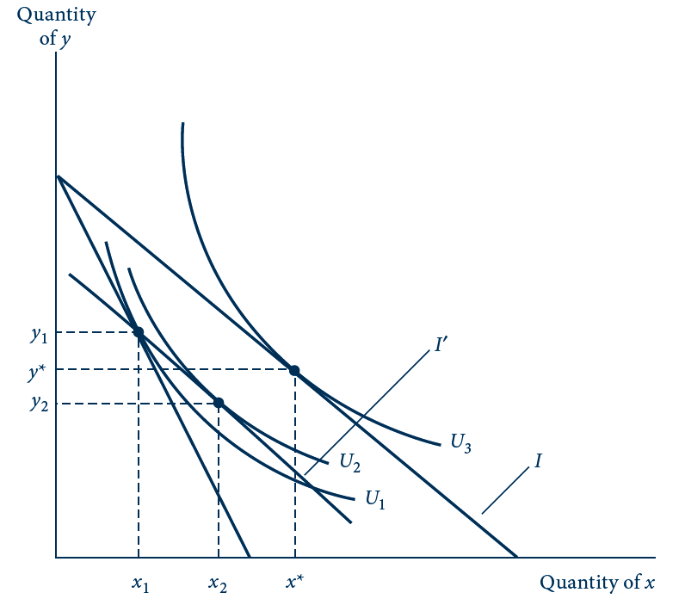
4.5
The Lump Sum Principle of Taxation
A tax on good x would shift the utility-maximizing choice from x*, y* to x₁, y₁. An income tax that collected the same amount would shift the budget constraint to I’. Utility would be higher (U₂) with the income tax than with the tax on x alone (U₁).

Slide 29
4.3 Indirect Utility
Cobb-Douglas utility function
With α= β= 0.5
x*=I/2p_{x} and y*=I/2p_{y}
The indirect utility function

Slide 30
4.3 Indirect Utility and the Lump Sum Principle
Fixed proportions
x*=I/[p_{x} + 0.25p_{y}] and y*=I/[4p_{x}+p_{y}]
The indirect utility function I

Slide 31
4.3 Indirect Utility and the Lump Sum Principle
The lump sum principle
Let I = 8, px = 1, py = 4
Commodity tax changes px to (px + tx)
Income tax changes I to (I – t)
Cobb-Douglas
If a tax of tx=$1 was imposed on good x
The individual will purchase x* = 2
Indirect utility will fall from 2 to 1.41
An equal-revenue lump sum tax will reduce income to $6 (t=2)
Indirect utility will fall from 2 to 1.5

Slide 32
4.3 Indirect Utility and the Lump Sum Principle
The lump sum principle with fixed-proportions
If a tax of $1 was imposed on good x
Indirect utility will fall from 4 to 8/3
An equal-revenue tax will reduce income to $16/3
Indirect utility will fall from 4 to 8/3
Since preferences are rigid, the tax on x does not distort choices

Slide 33
Expenditure Minimization
Utility maximization problem (UMP)
Dual problem: EMP (expenditure minimization problem)
Allocate income to achieve a given level of utility with the minimal expenditure
The goal and the constraint have been reversed

Slide 34
4.6
The Dual Expenditure-Minimization Problem
E₂
Quantity of y
E₃
B
E₁
A
y*
C
U₂
Quantity of x
x*
The dual of the utility-maximization problem is to attain a given utility level (U2) with minimal expenditures. An expenditure level of E1 does not permit U2 to be reached, whereas E3 provides more spending power than is strictly necessary. With expenditure E2, this person can just reach U2 by consuming x and y.

Slide 35
Expenditure Minimization
UMP
Objective function: utility function
Constraint: income
Domain (opportunity/choice set): budget set
Solution: Marshallian demand function
Dual EMP
Objective function: total expenditures
Constraint: utility
Domain (opportunity/choice set): upper level sets (at least as good sets in the consumption set)
Solution: Hicksian demand functions

Slide 36
Expenditure Minimization
The individual’s problem is to choose x₁,x₂,…,x_{n} to minimize
total expenditures = E = p₁x₁ + p₂x₂ +…+ p_{n}x_{n}
subject to the constraint
utility = Ū = U(x₁,x₂,…,x_{n})
The optimal amounts of x₁,x₂,…,x_{n} (Hicksian demand functions) will depend on the prices of the goods and the required utility level

Slide 37
Expenditure Minimization
Solution: Hicksian demand functions x_{i}(p₁,p₂,…,p_{n},U)
Expenditure function
E(p₁,p₂,…,p_{n},U) =
= p₁ x₁(p₁,p₂,…,p_{n},U)+ p₂ x₂(p₁,p₂,…,p_{n},U)+….
Minimal expenditure to achieve utility level U
Query. What are endogenous and exogenous variables in the EMP?

Slide 38
Expenditure Minimization
The expenditure function and the indirect utility function
Are inversely related
Both depend on market prices
But involve different constraints
Query. Identify the constraints of the UMP and EMP respectively.

Slide 39
4.4 Two Expenditure Functions
Cobb-Douglas
The indirect utility function in the two-good case:
If we interchange the role of utility and income (expenditure), we will have the expenditure function
E(p_{x},p_{y},U) = 2p_{x}^{0.5}p_{y}^{0.5}U

Slide 40
4.4 Two Expenditure Functions
Fixed-proportions case
The indirect utility function:
If we interchange the role of utility and income (expenditure), we will have the expenditure function
E(p_{x},p_{y},U) = (p_{x} + 0.25p_{y})U

Slide 41
Properties of Expenditure Functions
Homogeneity
A doubling of all prices will precisely double the value of required expenditures
Homogeneous of degree one in prices
Nondecreasing in prices
∂E/∂p_{i} ≥0 for every good
Concave in prices
Functions that always lie below tangents to them

Slide 42
4.7
Expenditure Functions Are Concave in Prices
E(p₁,…)
E^{pseudo}
E(p1,…)
E(p*₁,…)
p*₁
p1
At p₁ this person spends E(p₁* , . . .). If he or she continues to buy the same set of goods as p₁ changes, then expenditures would be given by E^{pseudo}. Because his or her consumption patterns will likely change as p₁ changes, actual expenditures will be less than this.

Slide 43
EMP and UMP
Solutions to the UMP and the EMP
Marshallian demand functions x_{i}(p1, p2,…,pn, I)
Hicksian demand functions x_{i}(p1, p2,…,pn, U)
Query.
What exactly do Hicksian demand functions identify?
What exactly do Marshallien demand functions identify?
Relate x_{i}(p1, p2,…,pn, U) to x_{i}(p1, p2,…,pn, I)

Slide 44
Budget Shares
Engel’s law
Fraction of income spent on food decreases as income increases
Budget shares, s_{i}=p_{i}x_{i} / I
Recent budget share data
Engel’s law is clearly visible
Cobb–Douglas utility function
Is not useful for detailed empirical studies of household behavior

Slide 45
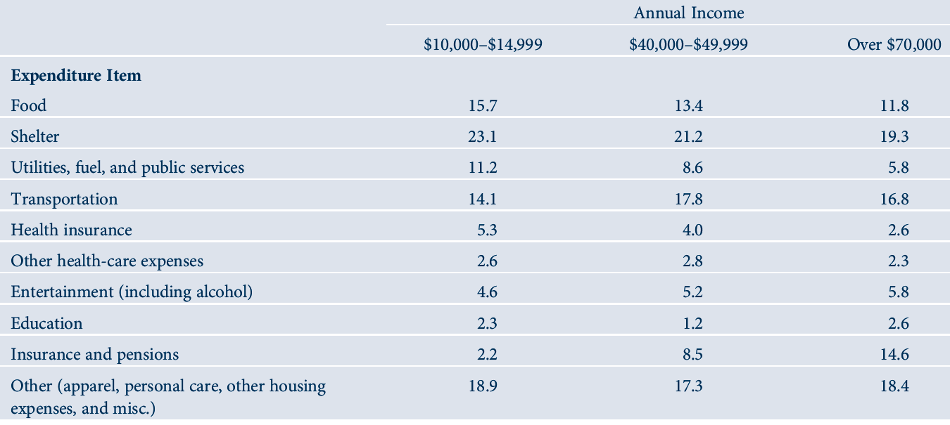
E4.1
Budget shares of U.S. households, 2008

Slide 46
Linear expenditure system
Generalization of the Cobb–Douglas function
Incorporates the idea that certain minimal amounts of each good must be bought by an individual (x₀, y₀)
U(x,y)=(x-x₀)^{α}(y-y₀)^{β}
For x ≥ x₀ and y ≥ y₀,
Where α+β=1

Slide 47
Linear expenditure system
Supernumerary income (I*)
Amount of purchasing power remaining after purchasing the minimum bundle
I*=I-p_{x}x₀-p_{y}y₀
The demand functions are:
x = (p_{x}x₀+αI*)/p_{x} and y = (p_{y}y₀+βI*)/p_{y}
The share equations:
s_{x}= α+(βp_{x}x₀-αp_{y}y₀)/I
s_{x}= β+(αp_{y}y₀ -βp_{x}x₀)/I
Not homothetic

Slide 48
CES utility
CES utility function
Budget shares:
s_{x}=1/[1+(p_{y}/p_{x})^{K}] and s_{y}=1/[1+(p_{x}/p_{y})^{K}]
Where K = δ/(δ-1)
Homothetic

Slide 49
The almost ideal demand system
Expenditure functions
Logarithmic differentiation

Slide 50
The almost ideal demand system
Almost ideal demand system
Expenditure function
Almost ideal demand system
Expenditure function
Homogeneous of degree one in the prices
a₁+a₂=1, b₁+b₂=0, and c₁+c₂=0

Slide 51
The almost ideal demand system

