Slide 1
Preferences and Utility

Slide 2
The Plan
Primary properties of preferences
  Completeness
  Transitivity
  Continuity
Utility
Indifference maps and substitution
Specific utility functions
Notes:
Start discussing properties preferences might have – among which the most important are….

Slide 3
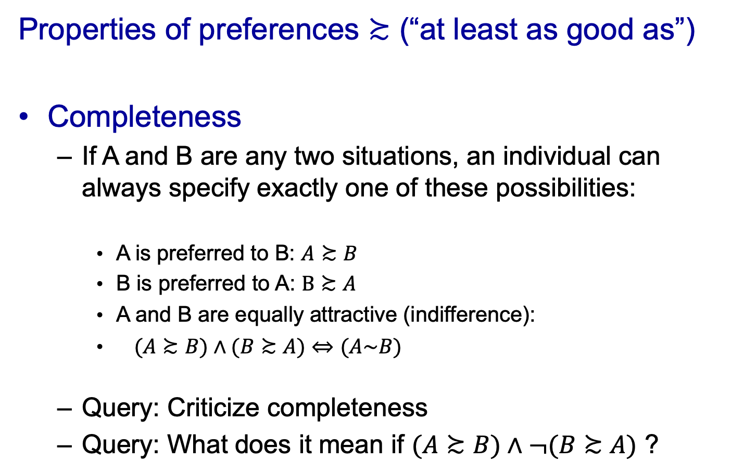
Axioms of Rational Choice
Properties of preferences $≿$ (“at least as good as”)
Completeness
  If A and B are any two situations, an individual can always specify exactly one of these possibilities:
    A is preferred to B: $A≿B$
    B is preferred to A: $B≿A$
    A and B are equally attractive (indifference):
    $(A≿B)∧(B≿A)$ $⇔$ $(A\sim B)$
  Query: Criticize completeness
  Query: What does it mean if $(A≿B)∧¬(B≿A)$ ?
Notes:
Prefs allow to compare diff. choices and identify those that are at least as good as…

Slide 4
Axioms of Rational Choice
Transitivity
  If A is preferred to B, and B is preferred to C, then A is preferred to C
  Individual’s choices are internally consistent
Complete + transitive = rational preferences

Slide 5
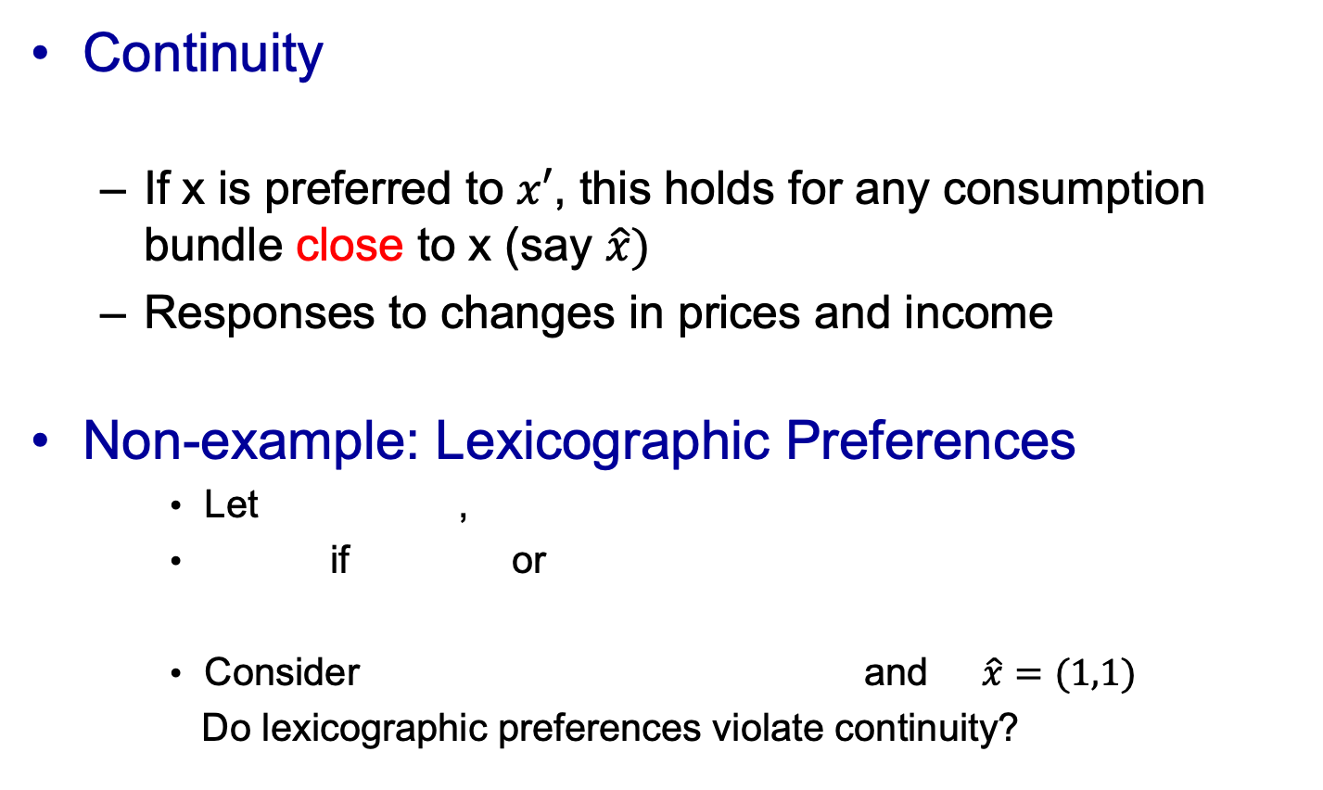
Primary properties of preferences
Continuity
  If x is preferred to $x′$, this holds for any consumption bundle close to x (say $\hat{x})$
  Responses to changes in prices and income
Non-example: Lexicographic Preferences
    Let ,
    if or
    Consider and $\hat{x}=(1,1)$
    Do lexicographic preferences violate continuity?

Slide 6
Utility
Assuming: completeness, transitivity, and continuity
  People are able to rank all possible situations from the least desirable to the most
Economists call this ranking utility
  If A is strictly preferred to B
  Then the utility assigned to A exceeds the utility assigned to B: U(A) > U(B)
Finite consumption set
  Utility function exists under completeness & transitivity

Slide 7
Utility
Utility
  Individuals’ preferences represented by a utility function of the form U(x₁, x₂, . . . , x_{n})
    Where x₁, x₂,…, x_{n} are the quantities of each of n goods that might be consumed in a period
    This function is unique only up to an order-preserving transformation
  Query. Show me a utility function PLUS two other utility functions representing the same preferences

Slide 8
Utility
Utility rankings are ordinal in nature
  Relative desirability of commodity bundles
  It makes no sense to consider how much more utility is gained from A than from B
  Impossible to compare utilities between people

Slide 9
Utility
More generally, utility is affected by
  The consumption of (physical) commodities
  Peer group (positional preferences)
  Personal experiences (habits)
  The general cultural environment

Slide 10
Utility
Utility from consumption of goods
  No habits, status, cultural factors (in this class)
  Individual may choose among many consumption goods: x₁, x₂,…, x_{n}
  utility = U(x₁, x₂,…, x_{n})
  In most cases in this class: individual chooses among two consumption goods: x, y
  utility = U(x,y)

Slide 11
Utility
Arguments of utility functions
  U(c,l) = utility from consumption (c) and leisure/labor supply (l)
  labor market models
  U(c₁,c₂) = utility from consumption in (two) different periods
  intertemporal (dynamic) models

Slide 12
Utility
Properties of preferences / utility functions
  Monotonicity (desirability)
  Substitutability (trade-offs)
  Convexity (love of variety /balancedness in consumption)

Slide 13
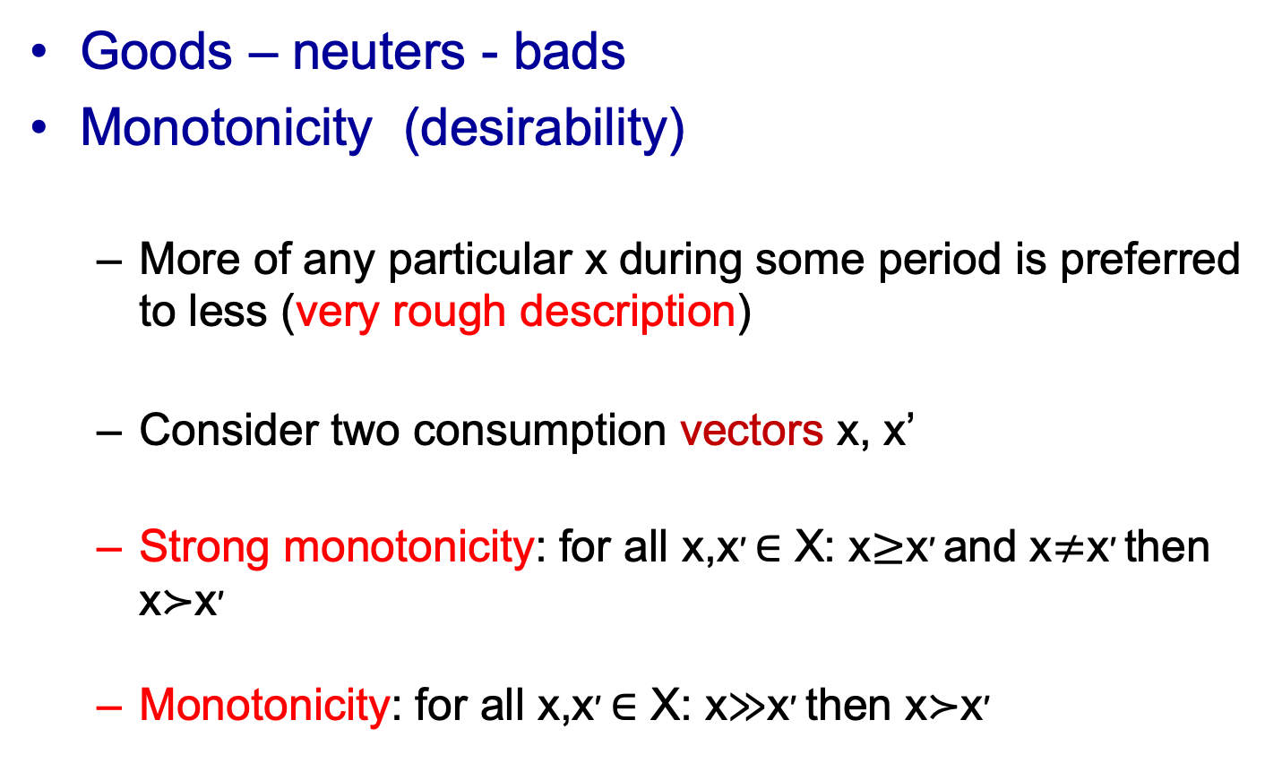
Utility
Goods – neuters - bads
Monotonicity (desirability)
  More of any particular x during some period is preferred to less (very rough description)
  Consider two consumption vectors x, x’
  Strong monotonicity: for all x,x′ ∈ X: x$≥$x′ and x$≠$x′ then x≻x′
  Monotonicity: for all x,x′ ∈ X: x≫x′ then x≻x′
Notes:
Individuals like more of a (every) commodity better!

Slide 14
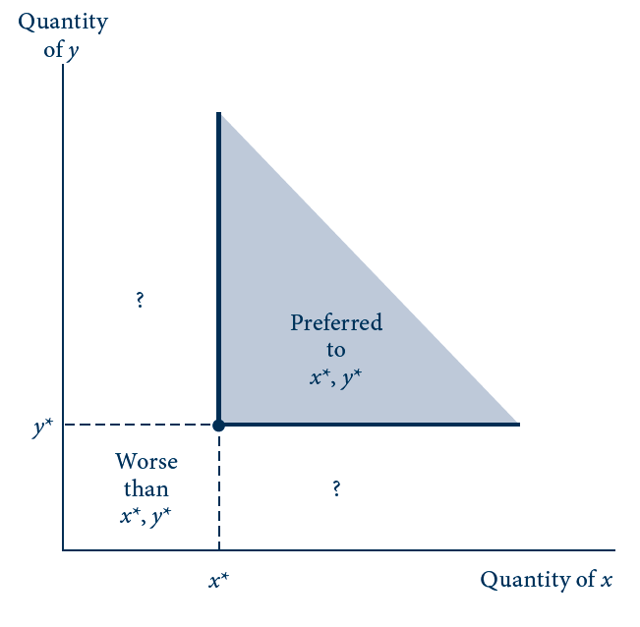
3.1
Strong Monotonicity: More of a Good Is Preferred to Less

Slide 15
Trades and Substitution
Indifference curve
  Shows a set of consumption bundles about which the individual is indifferent
  All consumption bundles that the individual ranks equally
  The bundles all provide the same level of utility
  Query. Consider
  Calculate the formula for an indifference curve y(x).

Slide 16
Substitution
Marginal rate of substitution, MRS
  The negative of the slope of an indifference curve (U₁) at some point
    Marginal rate of substitution at that point
  MRS changes as x and y change
    Reflects the individual’s willingness to trade y for x

Slide 17
3.2
A Single Indifference Curve
Quantity of y
y₁
y₂
U₁
Quantity of x
x₁
x₂
The curve U₁ represents those combinations of x and y from which the individual derives the same utility. The slope of this curve represents the rate at which the individual is willing to trade x for y while remaining equally well off. This slope (or, more properly, the negative of the slope) is termed the marginal rate of substitution. In the figure, the indifference curve is drawn on the assumption of a diminishing marginal rate of substitution.

Slide 18
Trades and Substitution
Indifference curve map
  Several indifference curves (based on same u)
  Level of utility represented by these curves increases as we move in a northeast direction
    Strong monotonicity: more of a good is preferred to less
Notes:
One way to represent preferences

Slide 19
3.3
There Are Infinitely Many Indifference Curves in the x–y Plane
Quantity of y
U₁ < U₂ < U₃
Increasing utility
U₃
U₂
U₁
Quantity of x
  Query: How about a situation in which one commodity is a good and one is a bad/a neuter?

Slide 20
Trades and Substitution
Indifference curves and transitivity
  Indifference curves cannot intersect

Slide 21
3.4
Intersecting Indifference Curves Imply Inconsistent
Monotone Preferences
Quantity of y
C
D
E
A
U₁
B
U₂
Quantity of x
Combinations A and D lie on the same indifference curve and therefore are equally desirable. But the axiom of transitivity can be used to show that A is preferred to D. Hence intersecting indifference curves are not consistent with rational preferences.
Notes:
C strictly preferred to D (not because of strong monotonicity) because C is strictly above indifference curve containing D
C > D = A > B transitivity: C > B but they are on same indiff curve -> transitivity does not hold

Slide 22
Trades and Substitution
Convexity of indifference curves
  Diminishing (or constant) MRS
  At least as good-sets are convex sets
  Preferences convex
  Query. What are convex sets?

Slide 23
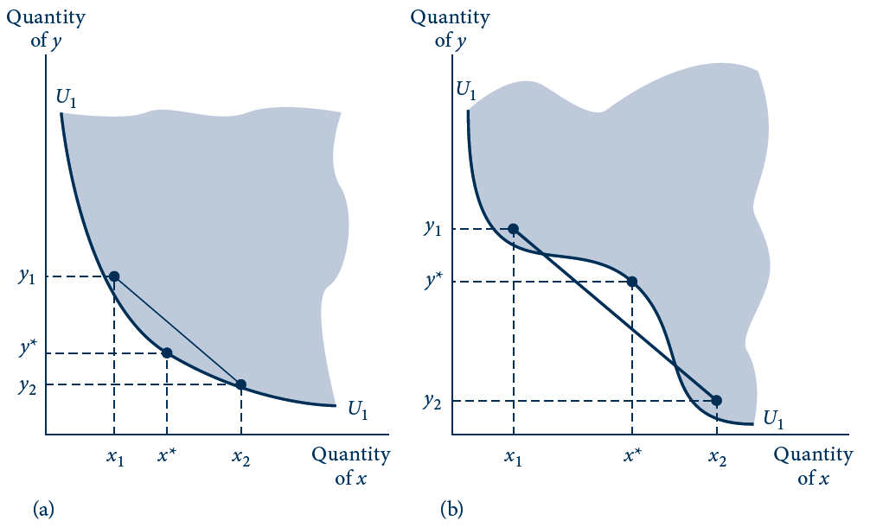
3.5
The Notion of Convexity as an Alternative Definition of a Diminishing MRS
In (a) the indifference curve is convex (any line joining two points above U₁ is also above U₁). In (b) this is not the case, and the curve shown here does not everywhere have a diminishing MRS.

Slide 24
Trades and Substitution
Strict convexity and balance in consumption
  Individuals prefer some balance in their consumption
  ‘‘Well-balanced’’ bundles of commodities are preferred to bundles that are heavily weighted toward one commodity

Slide 25
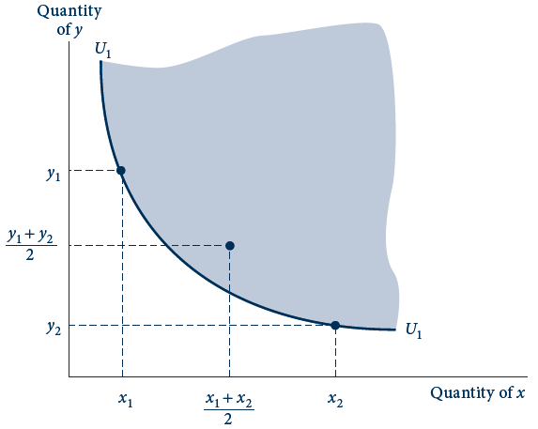
3.6
Balanced Bundles of Goods Are Preferred to Extreme Bundles
If indifference curves are convex (if they obey the assumption of a diminishing MRS), then the line joining any two points that are indifferent will contain points preferred to either of the initial combinations. Intuitively, balanced bundles are preferred to unbalanced ones.

Slide 26
3.1 Utility and the MRS
A person’s ranking of hamburgers (y) and soft drinks (x)
  Utility = SQRT(x·y)
An indifference curve for this function
  Identify that set of combinations of x and y for which utility has the same value
  Utility = 10, so 100=x·y, therefore y=100/x
MRS = -dy/dx(along U₁)=100/x²
  As x rises, MRS falls
    When x = 5, MRS = 4
    When x = 20, MRS = 0.25

Slide 27
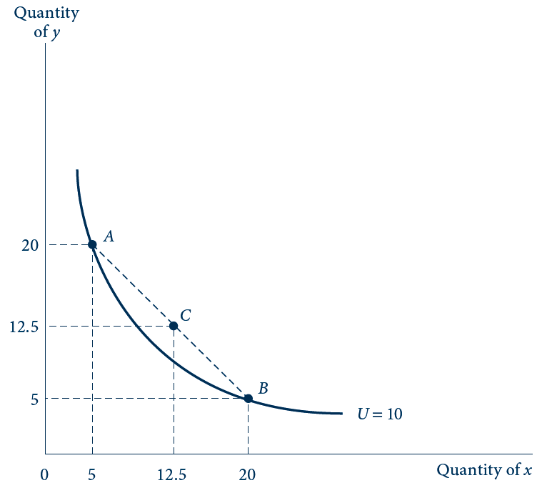
3.7
Indifference Curve for Utility=SQRT(x·y)
This indifference curve illustrates the function 10 = U = SQRT(x·y) . At point A (5, 20), the MRS is 4, implying that this person is willing to trade 4y for an additional x. At point B (20, 5), however, the MRS is 0.25, implying a greatly reduced willingness to trade.

Slide 28

The Mathematics of Indifference Curves
An individual consumes x and y
  Utility = $U\left(x,y\right)$
  Specific level of utility, $\overline{u}$: $U\left(x,y\right)=\overline{u}$
  Trade-offs: the rate at which y can be traded for x
    Query. By totally differentiating $U\left(x,y\right)=\overline{u}$, verify that the above is true.

Slide 29
The Mathematics of Indifference Curves
Diminishing MRS
  Convex indifference curves
  Convex upper level sets
  Requires that the utility function be quasi-concave
    Query. Discuss the case of a constant MRS

Slide 30
3.2 Showing Convexity of Indifference Curves
MRS is diminishing as x increases and y decreases
Therefore, the indifference curves are convex

Slide 31
3.2 Showing Convexity of Indifference Curves
MRS is diminishing as x increases and y decreases
Therefore, the indifference curves are convex

Slide 32
3.2 Showing Convexity of Indifference Curves
as x increases and y decreases, the MRS increases!
indifference curves are concave, not convex (-> nonconvex preference)
not a quasi-concave function U(x,y)

Slide 33
Utility Functions for Specific Preferences
Cobb-Douglas Utility
utility = U(x,y) = x^{α}y^{β}
  Where α and β are positive constants
  The relative sizes of α and β indicate the relative importance of the goods

Slide 34
Utility Functions for Specific Preferences
Perfect substitutes
  Linear indifference curves
utility = U(x,y) = αx + βy
  Where α and β are positive constants
  The MRS will be constant along the indifference curves

Slide 35
Utility Functions for Specific Preferences
Perfect complements
  L-shaped indifference curves
utility = U(x,y) = min (αx, βy)
  where α and β are positive parameters

Slide 36
Utility Functions for Specific Preferences
CES Utility (constant elasticity of substitution)
utility = U(x,y) = ⍺x^{δ}/δ+ ßy^{δ}/δ , δ≤1, ⍺,ß>0
Perfect substitutes: δ= 1
Cobb-Douglas: δ= 0
Perfect complements: δ= -∞
Query. Show that δ= 0 corresponds to Cobb-Douglas
Notes:
Take care with Cobb Douglas. Expand a (x^d-1)/d … so that l’Hopital can be applied

Slide 37
Utility Functions for Specific Preferences
The elasticity of substitution, σ
  CES utility: σ = 1/(1 - δ)
  Perfect substitutes: σ = ∞
  Perfect complements: σ = 0
  Query. What is σ for a Cobb-Douglas function?

Slide 38
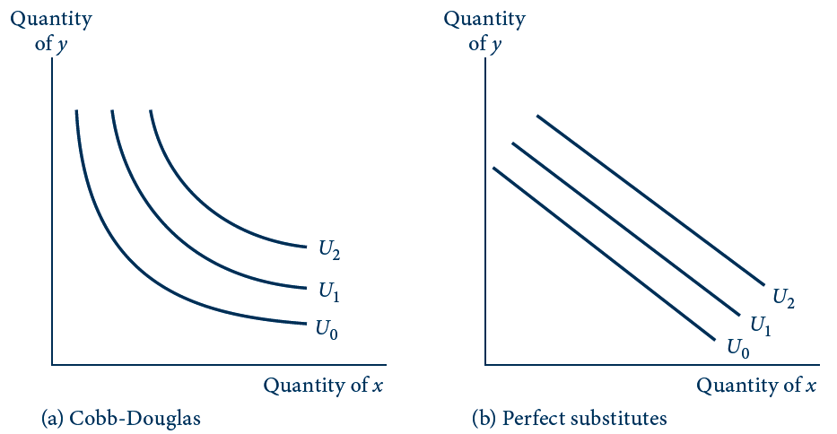
3.8 a, b
Examples of Utility Functions
The four indifference curve maps illustrate alternative degrees of substitutability of x for y. The Cobb–Douglas and constant elasticity of substitution (CES) functions (drawn here for relatively low substitutability) fall between the extremes of perfect substitution (b) and no substitution (c).

Slide 39
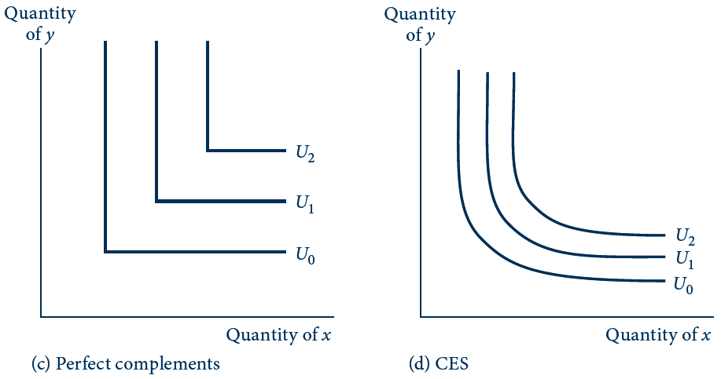
3.8 c, d
Examples of Utility Functions
The four indifference curve maps illustrate alternative degrees of substitutability of x for y. The Cobb–Douglas and constant elasticity of substitution (CES) functions (drawn here for relatively low substitutability) fall between the extremes of perfect substitution (b) and no substitution (c).

Slide 40
3.3 Homothetic Preferences
Utility function is homothetic
  If the MRS depends only on the ratio of the amounts of the two goods -> implication?
Perfect substitutes
  MRS is the same
  at every point
Perfect complements
  MRS = ∞ if y/x > α/β
  MRS is undefined if y/x = α/β
  MRS = 0 if y/x < α/β

Slide 41
3.3 Homothetic Preferences
General Cobb-Douglas function
  The MRS depends only on the ratio y/x

Slide 42
3.4 Nonhomothetic Preferences
Some utility functions do not exhibit homothetic preferences
utility = U(x,y) = x + ln y
  Good y exhibits diminishing marginal utility, but good x does not
  The MRS diminishes as the chosen quantity of y decreases, but it is independent of the quantity of x consumed
Notes:
parallel indifference curves along the x-axis

Slide 43
The Many-Good Case
Suppose utility is a function of n goods given by
utility = U(x₁, x₂,…, x_{n})
U(x₁, x₂,…, x_{n})=k
  Defines an indifference surface in n dimensions
    All those combinations of the n goods that yield the same level of utility

Slide 44
The Many-Good Case
MRS with many goods

Slide 45
Special Preferences
The utility function
  General concept
  Can be adapted to a large number of special circumstances
Aspects of preferences that economists have tried to model
    (1) habits and addiction
    (2) positional preferences

